Slide 1
Beyond proportional hazards
Hajime Uno, Ph.D
Division of Population Sciences
DFCI/HMS
BCB: How It's Done Seminar
December 4, 2014

Slide 2
Acknowledgements
Brian Claggett
Lu Tian
LJ Wei
ECOG for data sharing of E4A03 trial

Slide 3
Setting
Consider
a clinical trial to compare two groups
a time-to-event outcome is of interest
We need to report a single number that summarizes the between-group difference.
- What do we do?
- How is it done?
Let us go beyond PH!!
KM → Logrank test → Cox PH & report HR

Slide 4

How we got to “almost routinely” use Cox PH and hazard ratio?
Many experiences in practice
Several desirable properties
Using these might be already in our
comfort zone?
Everyone knows
Elegant, rigorous theories
Hardly get criticized

Slide 5

It is great, but….
… we might be getting NOT to pay much attention to the issues on hazard ratio in practice, although we know the issues well?

Slide 6
Outline
Issues and concerns of HR estimate
Alternatives to HR -- model-free summary measures
Examples from cancer trials
Implementation with R
Conclusions

Slide 7
Issues and concerns about hazard ratio estimate (1)
No reference number A ratio of 0.8 is difficult to interpret clinically without any absolute hazard to serve as reference
… even if the PH assumption is correct

Slide 8
Issues and concerns about hazard ratio estimate (2)
Decision-making in rare event cases
When the number of events is small, the hazard ratio estimate is very unstable and the confidence interval is wide, implying that there is not enough information to make a decision
… even if the PH assumption is correct

Slide 9
Issues and concerns about hazard ratio estimate (3)
… if the PH assumption is violated
It is difficult to interpret the parameter being estimated. It is not a simple average of the hazard ratio over time
The parameter to be estimated depends on underlying study-specific censoring distributions
ex) These two designs are estimating different HR’s Design 1: accr. 200 for 1Y, FU until observing 100 of events Design 2: accr. 200 for 2Y, FU until observing 100 of events
!! Any estimate for a model-based between-group difference metric has the similar issue…

Slide 10
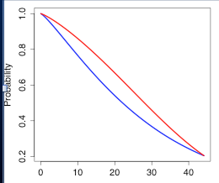
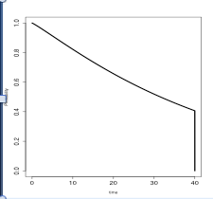
A numerical study for illustration
Consider two groups and their true survival functions
Consider a common censoring time distribution
Generate 1 million of for each group and get “observable” survival data
Calculate the HR by the PH estimator
Group R
Group B
TRUE Survival
Time Distributions
Censoring Time
Distribution

Slide 11
“TRUE” Survival functions
“TRUE” Hazard Ratio
HR=0.77
HR=0.71
HR=0.82
Non-PH
Group R
Group B
Study-specific censoring distribution
Study (1)
Study (2)
Study (3)

Slide 12
“TRUE” Survival functions
“TRUE” Hazard Ratio
HR=0.80
HR=0.80
HR=0.80
Proportional Hazards!
Group R
Group B
Study-specific censoring distribution
Study (1)
Study (2)
Study (3)

Slide 13
Example
ECOG E4A03: A phase III randomized trial to compare low- and high-dose dexamethasone for newly diagnosed multiple myeloma
N=445 (223 on high-dose, 222 on low-dose)
One of the endpoints was overall survival

Slide 14

Example (ECOG E4A03)
Low-dose
High-Dose
In favor of high-dose
Rajkumar (2010)
In favor of low-dose
High:
Low:
223 210 200 189 180 172 124 90
222 218 214 208 209 193 147 96
HR= 0.87 (0.95CI: 0.60 to 1.27), p=0.46
How do we interpret 0.87 ??

Slide 15
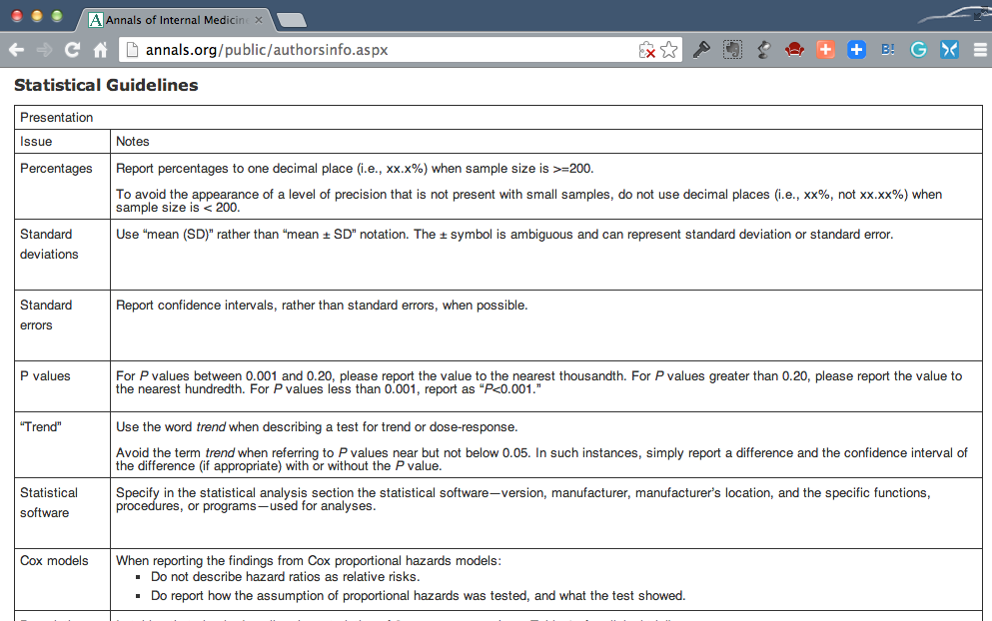
Ref. Annals of Internal Medicine, Guideline for Authors
http://annals.org/public/authorsinfo.aspx

Slide 16
It seems checking the PH assumption is important …
Check by your eye ball – (subjective…)
Log(-log(S(t))) vs. t
Statistical tests
Include time-varying covariates in Cox’s model
Goodness of fit tests
Schoenfeld residuals (Schoenfeld, 1982)
Weighted residuals (Grambsh & Therneau, 1994)
Cumulative residuals (Lin & Wei, 2002)

Slide 17
But, can we actually rule out non-PH cases by statistical tests?
Testing the PH assumption
H₀: “PH is correct”
H₁: “PH is NOT correct”
N.S. does not necessary means “H₀: PH is correct” is true
Also, if sample size is huge, a significant p-value will be observed even with a tiny deviation from the PH

Slide 18
Need a single number to summarize the difference between two functions
No perfect summary
Example (ECOG E4A03)
Low-dose
High-Dose
Desirable ones: ... do not need a strong modeling assumption on the relationship between the two curves
→ model-free measures
High:
Low:
223 210 200 189 180 172 124 90
222 218 214 208 209 193 147 96

Slide 19
(1) t-year survival probability
Example (ECOG E4A03)
Low-dose
High-Dose
1-year?
2-year?
3-year?
High:
Low:
223 210 200 189 180 172 124 90
222 218 214 208 209 193 147 96

Slide 20
(2) Median survival time
Example (ECOG E4A03)
Low-dose
High-Dose
???
Sometimes this is
inestimable…
High:
Low:
223 210 200 189 180 172 124 90
222 218 214 208 209 193 147 96

Slide 21
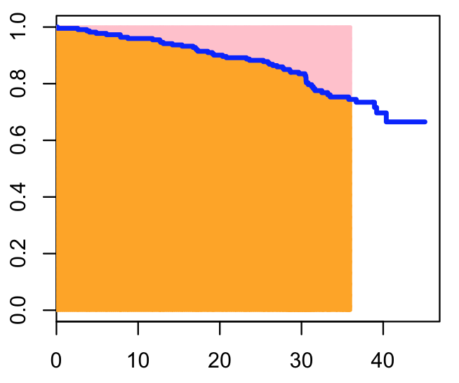
(3) Restricted mean survival time (RMST)
Interpretation:
If you follow-up patients on low-dose for 36m, patients will survive 32.5 months in average
Low-dose
32.5 months
Note:
RMST is estimable even when median survival time is inestimable

Slide 22
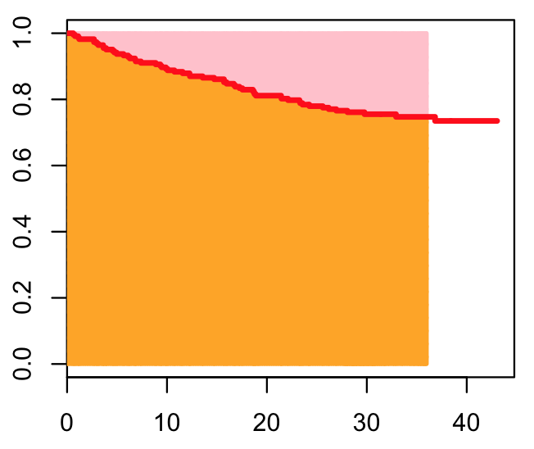
(3) Restricted mean survival time (RMST)
Low-dose
high-dose
32.5 months
30.3 months

Slide 23
(3) Restricted mean survival time (RMST)
Difference in RMST: 2.2 months (0.95CI: 0.5 to 4.0, p<0.01)
Recall: HR= 0.87 (0.95CI: 0.60 - 1.27), NS
Low-dose
high-dose
32.5 months
30.3 months

Slide 24
(4) Restricted mean time lost (RMTL)
The area above the survival curve
Interpretation
If you follow-up patients on low-dose for 36m, patients will lose time 3.5 months in average
Low-dose
32.5 months

Slide 25
(4) Restricted mean time lost (RMTL)
Ratio of RMTL: 3.5/5.7=0.61 (0.95CI: 0.42 to 0.90, p<0.01)
Low-dose
high-dose
3.5m
5.7m
32.5 months
30.3 months

Slide 26
Lesson we learned from this example (a cross-hazards case)
The PH assumption is clearly violated; the interpretation of HR is rather difficult
Median survival time is a robust summary but was inestimable with this example
RMST or RMTL would be a good alternative when summarizing the between-group difference
HR-based tests did not have power (due to the cross-hazards), but a significant difference was seen with the RMST-based tests

Slide 27
Other examples from cancer trials

Slide 28
Zukin et al. (2013, JCO)
A randomized controlled trial to compare OS between single-agent pemetrexed (P) and the combination of carboplatin and pemetrexed (CP) in patients with advanced NSCLC with an ECOG PS of 2
N=103 (CP arm) and N=98 (P arm)
Median follow-up time is 27.5 months
Median survival: CP (9.3m) and P (5.3m)

Slide 29
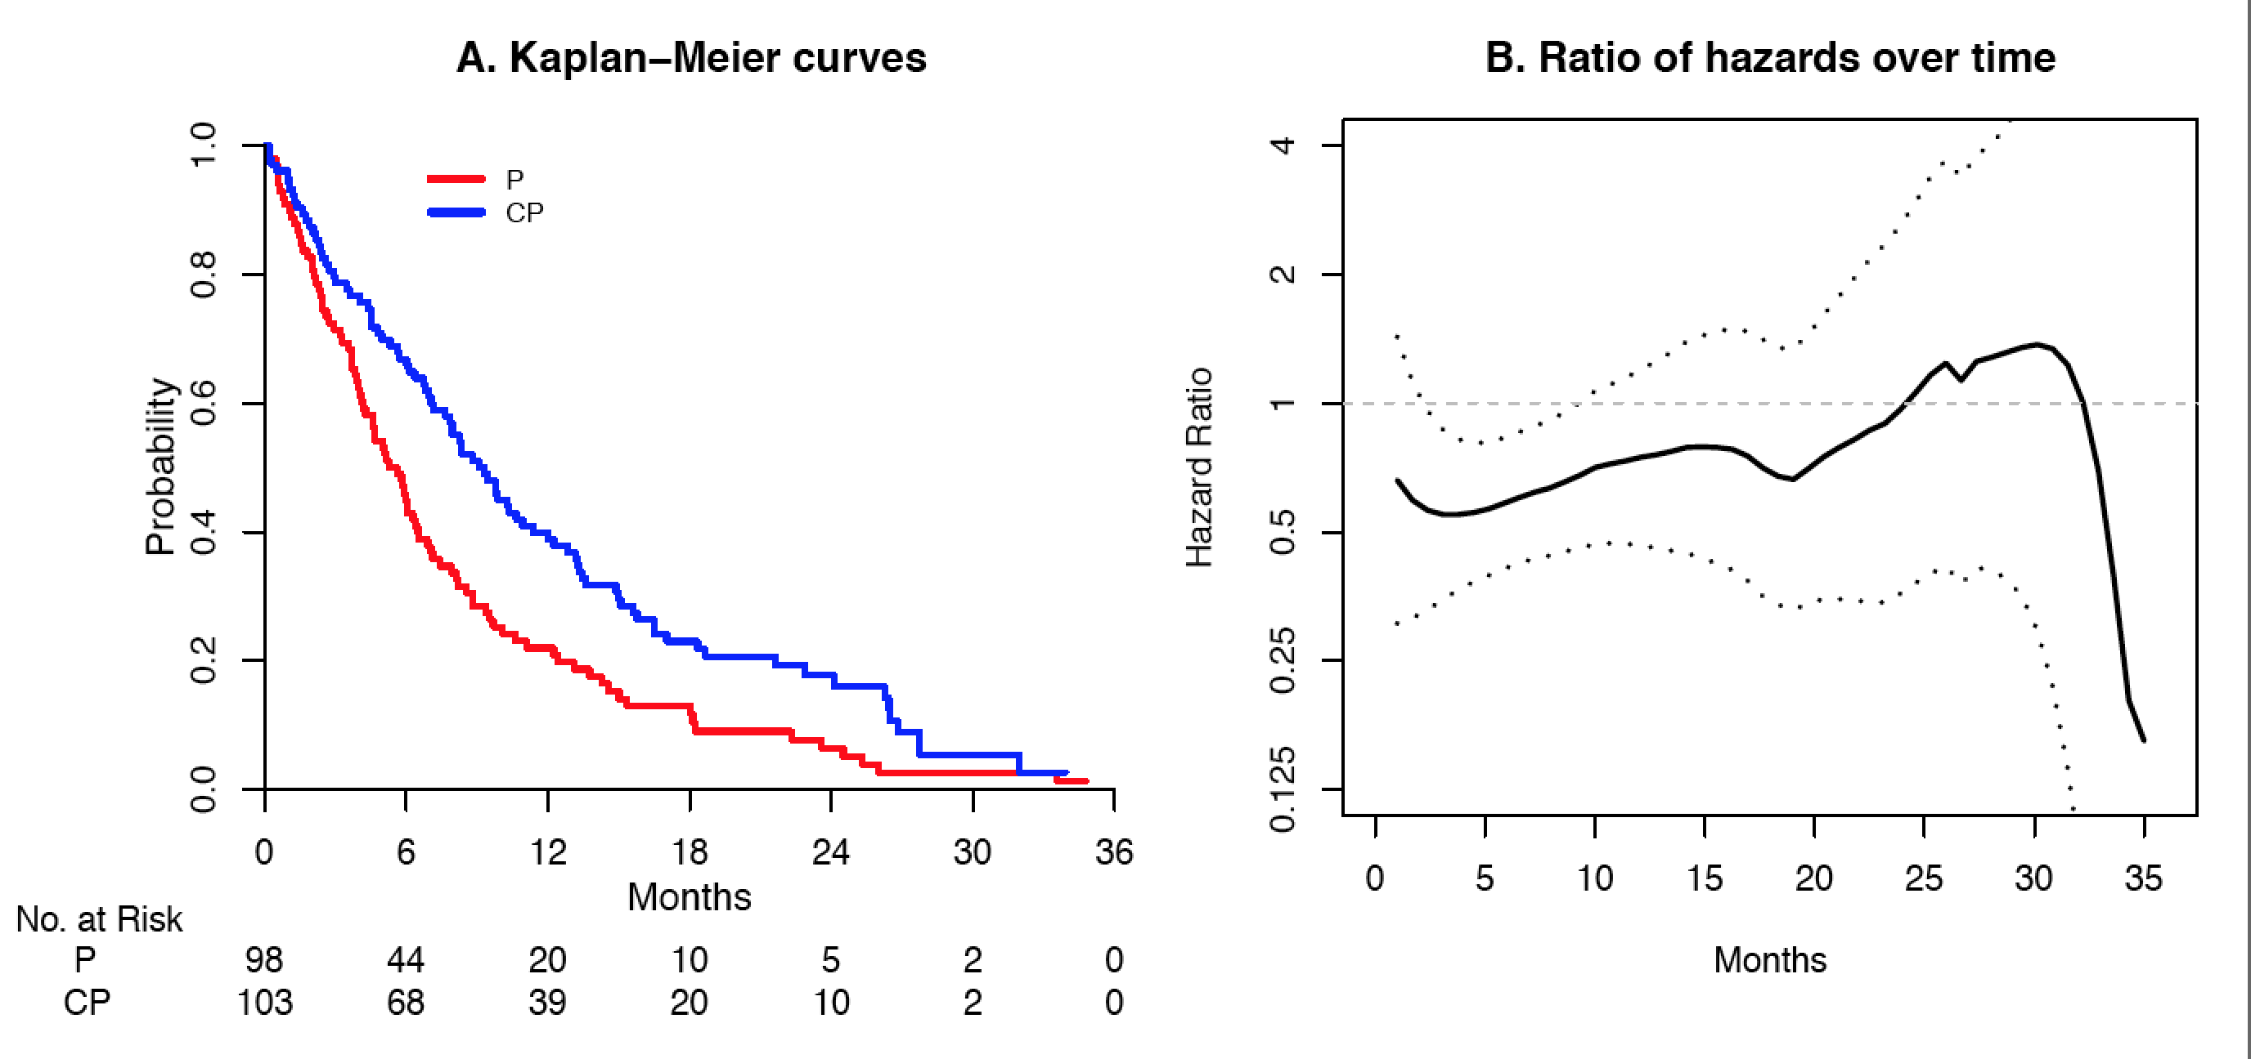
Zukin et al. (2013, JCO) Advanced NSCLC, OS
RMST [35m]
P:7.9m
CP:11.8m
HR: 0.62 (0.46 to 0.83) **
RMST [35m] Difference:3.9 (1.5 to 6.3) **
RMST [35m] Ratio: 1.49 (1.17 to 1.91) **
Notes:
single-agent pemetrexed (P) and the combination of carboplatin and pemetrexed (CP)

Slide 30
Lesson we learned from this example
RMST works for not only cross-hazard cases (“qualitative interaction”) but also non cross-hazard cases (“quantitative interaction”)
The HR-based test also worked for this “quantitative” interaction example, but the resulting HR estimate would be still hard to interpret

Slide 31
Allegra et al. (2013, JCO)
A randomized trial to assess efficacy and safety of the combination of bevacizumab and modified FOLFOX6 (mFF6), as the adjuvant therapy, in patients with stage II/III colon cancer.
N=1341 (mFF6 arm) and N=1337 (bev+mFF6 arm)
Median follow-up time is 4.9 years
Median survival: Not reached

Slide 32
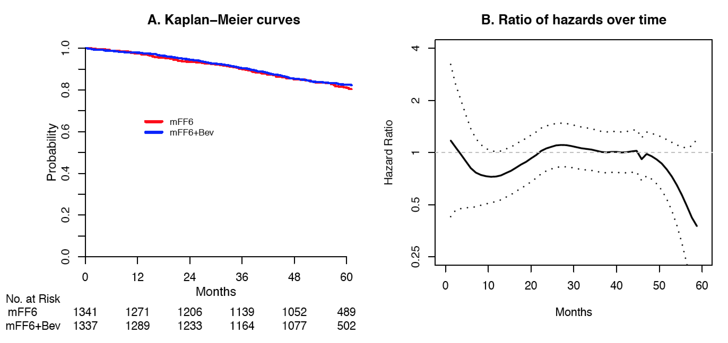
Allegra et al. (2013, JCO) Stage II/III colon cancer, OS
RMST [60m]
mFF6: 54.9m
mFF6+Bev: 55.2m
HR: 0.95 (0.79 to 1.13)
RMST [60m] Difference: 0.3 (-0.7 to 1.3) months
RMST [60m] Ratio: 1.00 (0.99 to 1.02)
Notes:
combination of bevacizumab and FOLFOX6 vs FOLFOX6

Slide 33
Lesson we learned from this example
The confidence interval for the hazard ratio is rather wide (0.79 to 1.13) due to relatively small number of events. The evidence from this analysis is inconclusive due to the lack of information
The CI for difference (or ratio) of RMSTs are tight around 0 (or 1). We can claim that (at least for the RMST) these two groups are not clinically significantly different (<2% difference over 60 months)

Slide 34
Summary
Need to be cautious when using model-based metrics, such as HR
When model assumptions do not hold, the interpretation is rather difficult
Model-free and clinically interpretable metrics such as RMST would be a better choice, unless we are confident that the model assumption is correct

Slide 35
Implementations

Slide 36
survRM2 package
The package location (for now): BCB Unix: ~/huno/share/
survRM2_1.0.tar.gz (Source)
survRM2_1.0.tgz (Mac binary)
survRM2_1.0.zip (Windows binary)
survRM2_vignette (Package Vignette)
What the package can do:
Calculating RMST and CI for each group
Two-sample comparison based on the RMST (difference in RMST, ratio of RMST, and ratio of RMTL)
ANCOVA type covariate adjustment for these three between-group contrast measures

Slide 37
Sample data used in the package manual/vignette
(PBC data, Fleming & Harrington 1991)
> library(survRM2)
> D=rmst2.sample.data()
> nrow(D)
[1] 312
> head(D)
time status arm age edema bili albumin protime
1 1.095140 1 0 58.76523 1.0 14.5 2.60 12.2
2 12.320329 0 0 56.44627 0.0 1.1 4.14 10.6
3 2.770705 1 0 70.07255 0.5 1.4 3.48 12.0
4 5.270363 1 0 54.74059 0.5 1.8 2.54 10.3
5 4.117728 0 1 38.10541 0.0 3.4 3.53 10.9
6 6.852841 1 1 66.25873 0.0 0.8 3.98 11.0

Slide 38
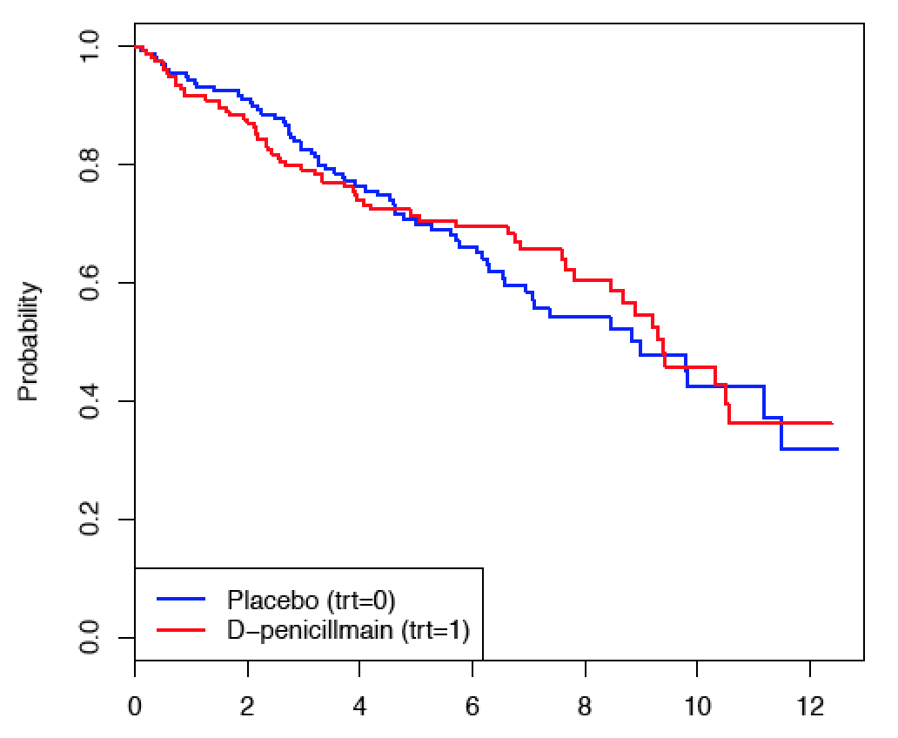
KM plots
Years

Slide 39
> foo=rmst2(time, status, arm, tau=10)
> print(foo)
The truncation time: tau = 10 was specified.
Restricted Mean Survival Time (RMST) by arm
Est. se lower .95 upper .95
RMST (arm=1) 7.283 0.295 6.704 7.863
RMST (arm=0) 7.146 0.283 6.592 7.701
Restricted Mean Time Lost (RMTL) by arm
Est. se lower .95 upper .95
RMLT (arm=1) 2.717 0.295 2.137 3.296
RMTL (arm=0) 2.854 0.283 2.299 3.408
Between-group contrast
Est. lower .95 upper .95 p
RMST (arm=1)-(arm=0) 0.137 -0.665 0.939 0.738
RMST (arm=1)/(arm=0) 1.019 0.912 1.139 0.738
RMTL (arm=1)/(arm=0) 0.952 0.714 1.270 0.738

Slide 40
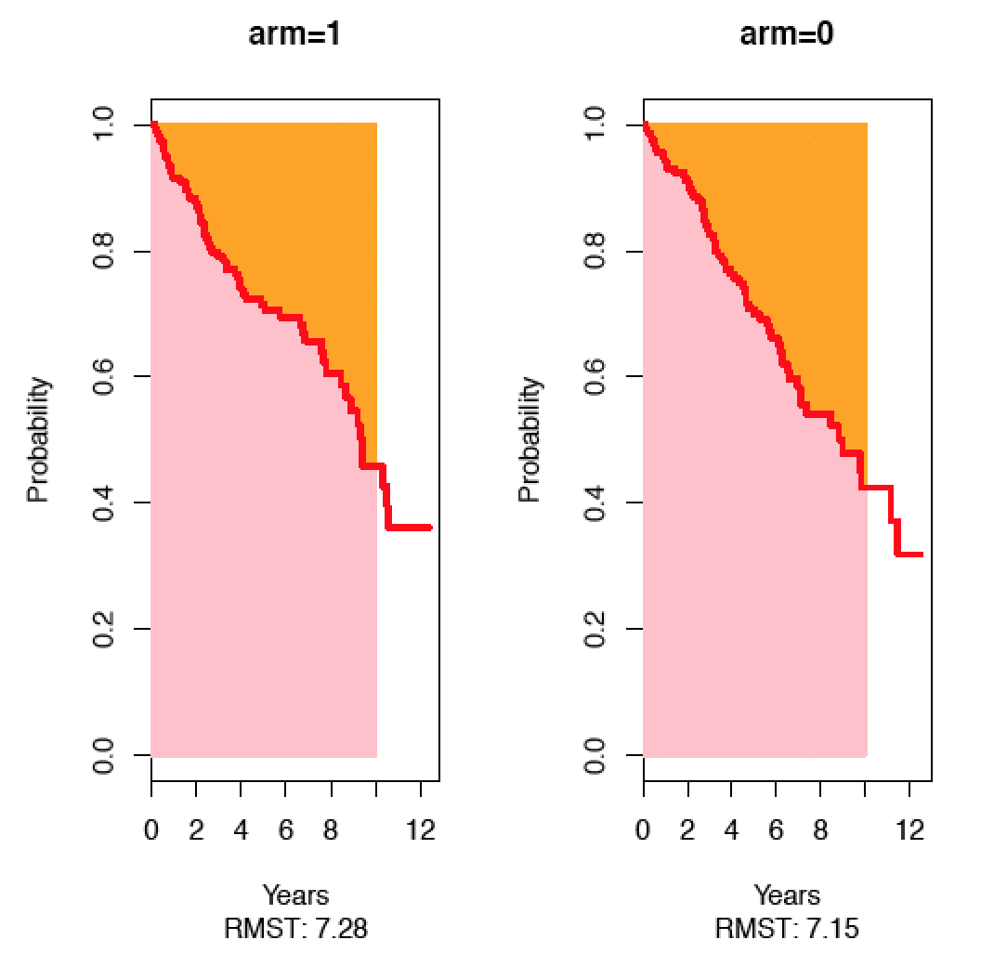
> plot(foo, xlab="Years", ylab="Probability"))

Slide 41
About the truncation time “tau”
Default value:
When tau is NULL or not specified in rmst2()
> rmst2(time, status, arm, tau=NULL)
or
> rmst2(time, status, arm)
The default tau is the minimum of the largest observed event time in each of the two groups

Slide 42
Years

Slide 43
About the truncation time “tau”
In RCT, tau should be pre-specified in the protocol
Note that tau needs to be smaller than or equal to the default tau, because the KM cannot well estimate the survival function beyond the last observed event time
In this example, the default tau was 10.5 years
> rmst2(time, status, arm, tau=12)
Error in rmst2(time, status, arm, tau = 12) :
The truncation time, tau, needs to be shorter than or equal to the minimum of the largest observed event time on each of the two groups: 10.549

Slide 44
Adjusted analysis
The package also implements ANCOVA-type adjusted analyses proposed by Tian et al. (2014, Biostatistics)
> head(x)
age bili albumin
1 58.76523 14.5 2.60
2 56.44627 1.1 4.14
3 70.07255 1.4 3.48
4 54.74059 1.8 2.54
5 38.10541 3.4 3.53
6 66.25873 0.8 3.98
> rmst2(time, status, arm, tau=10, covariates=x)

Slide 45
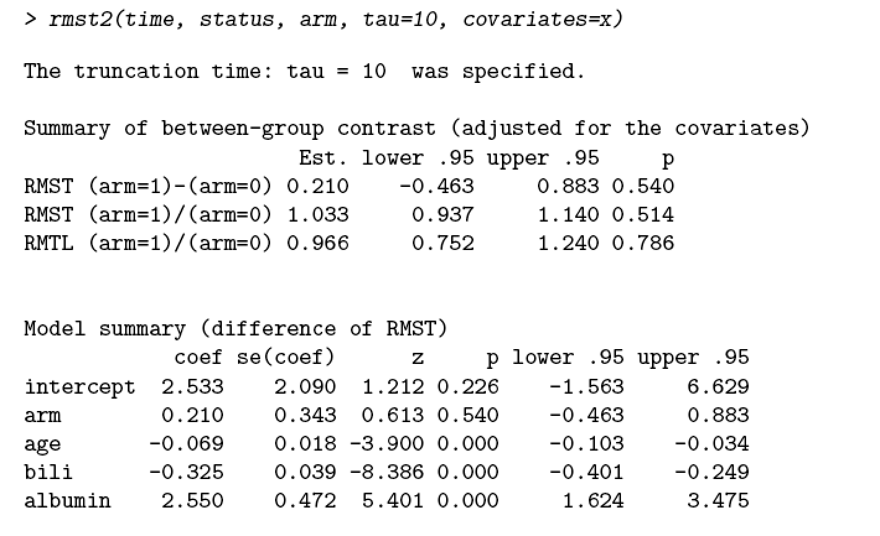

Slide 46
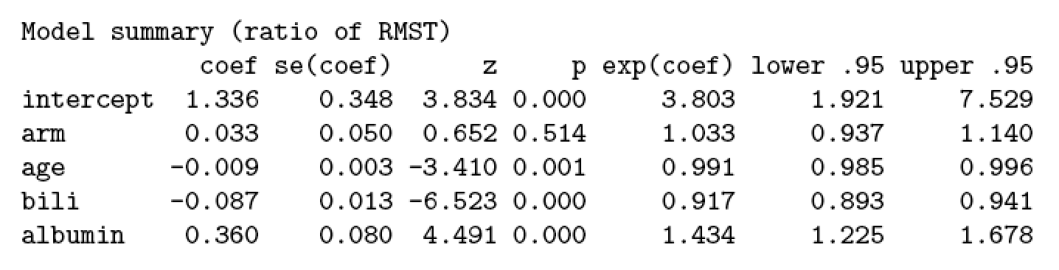
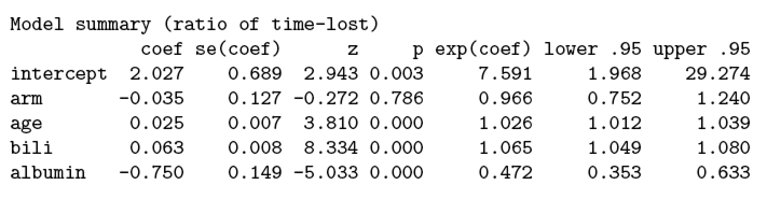

Slide 47
Conclusions
Hazard ratio estimate and log-rank test are routinely used for designing, monitoring and analyzing clinical studies with time to event data, but it is not always the best approach
When there is no strong empirical or biological evidence that the PH assumption is valid, a model-free summary measure for the between-group difference is preferred
We should not tend to stay in our comfort zone. We should be brave enough to employ alternative methods in practice, when they are more appropriate

Slide 48
END

Slide 49
References
Uno et al. (2014). Moving beyond the hazard ratio in quantifying the between-group dierence in survival analysis. JCO 32, 2380-2385.
Miller (1981). Survival Analysis. Wiley.
Tian et la. (2014). Predicting the restricted mean event time with the subject's baseline covariates in survival analysis. Biostatistics 15, 222-233.
Andersen et al. (2004). Regression analysis of restricted mean survival time based on pseudo-observations. Lifetime data analysis 10, 335-350.
Klein et al. (2008). SAS and R functions to compute pseudo-values for censored data regression. Computer methods and programs in biomedicine 89, 289-300.
Parner & Andersen (2010). Regression analysis of censored data using pseudo-observations. Stata Journal.
Murray & Tsiatis (1995) Sequential methods for comparing years of life saved in the two-sample censored data problem. 55:1085–92.

